Slide 1
Capstone project
Opening a new café in Mumbai city
Farah Pankhania

Slide 2
Introduction
When you invest in a coffee shop franchise, you are essentially creating a location for your neighbours to meet and socialize, thus playing a crucial part in building a strong and close-knit community.
They prove to be a form of a relaxation, entertainment and a hangout place for people of all ages. Thus, local budding entrepreneurs look forward to setting up and investing in a cafe shop.
In order for a cafe to profitable, there should be enough customers and to get enough customers, it is not beneficial to set up a cafe in the vicinity of the existing ones.
Also, the location of a cafe has a significant impact on the expected returns.

Slide 3
Business problem
The main objective of this Capstone Project is to analyse and select the best location in Mumbai city to open a cafe. We will be using data science methodology and machine learning techniques to answer the following business problem- If a local entrepreneur/ investor wishes to open a coffee shop in the city of Mumbai, India; where would you recommend that they open it?

Slide 4
Target audience
Mumbai is the financial, commercial and entertainment capital of India. It is one of the biggest cities in India with a large population.
Opening a cafe here would be beneficial to anyone who is a local entrepreneur/investors or who is looking forward to expand their businesses.

Slide 5
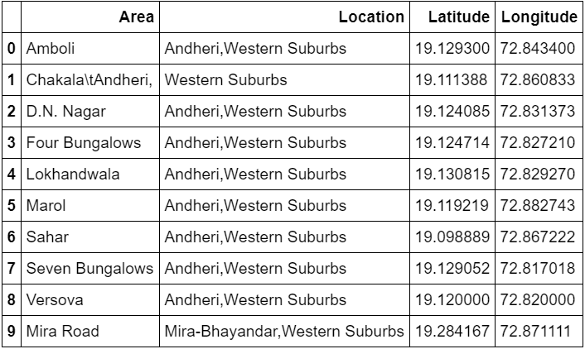
DATA SOURCES
Mumbai neighbourhood dataset from Wikipedia. This data contains the latitude and longitude coordinates for all neighbourhoods- https://en.wikipedia.org/wiki/List_of_neighbourhoods_in_Mumbai
Foursquare API- To obtain venue data of neighbourhoods.

Slide 6
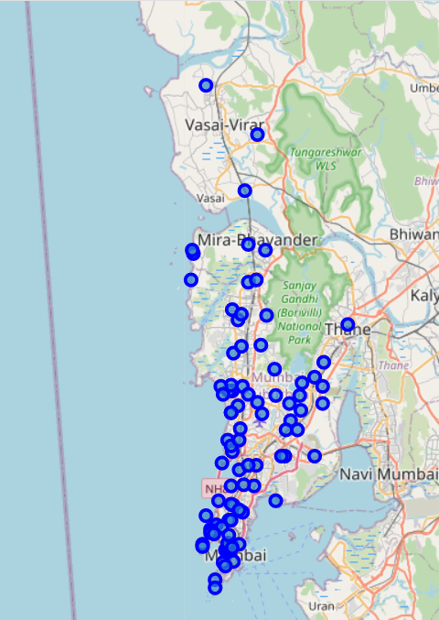
METHODOLOGY
Scraping the Wikipedia web page to obtain neighbourhood list
Obtain the above data and store it in pandas data frame along with latitude and longitude values.
Use Foursquare API to get venue data.
Group data by neighbourhood and take mean of the frequency of occurrence of each category.
Filter venue by Coffee Shops
Perform clustering on the data by using k-means clustering algorithm.
Visualize the clusters in a map using Folium.

Slide 7
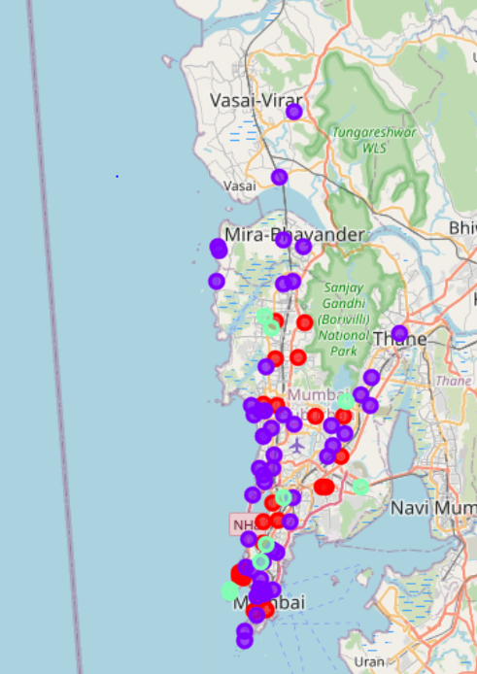
RESULTS AND DISCUSSION
So, we were able to categorize neighbourhoods into 3 categories:
Cluster 0 (Red): Neighbourhoods with moderate number of Coffee shops.
Cluster 1(Purple): Neighbourhoods with high concentration of coffee shops.
Cluster 2 (Green): Neighbourhoods with low number to no existence of coffee shops.
Also, we can observe that there is a high concentration of cafes in the southern part of Mumbai.

Slide 8
CONCLUSION
Most of the cafes are concentrated in the southern area of Mumbai city, with the highest number in cluster 1 and moderate number in cluster 0. On the other hand, cluster 2 has very low number to totally no coffee shops in the neighbourhoods. This represents a great opportunity and high potential areas to open new cafes as there is very little to no competition from existing ones.
Meanwhile, cafes in cluster 1 are likely suffering from intense competition due to oversupply and high concentration of cafes. The suburb areas still have very few coffee shops.
Therefore, this project recommends local cafe entrepreneurs to utilize these findings to open new shops in neighbourhoods in cluster 2 with little to no competition. Entrepreneurs who have a unique selling proposition can also open cafes in Cluster 1 which has moderate competition. Lastly, they are advised to avoid neighbourhoods in cluster 2 which already have high concentration of cafes and are already suffering from high competition.

